Slide 1
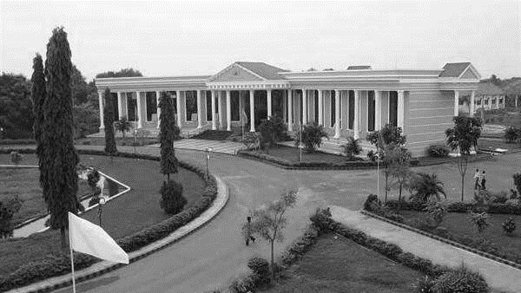



AUTOMATED ANSWER EVALUATION USING MACHINE LEARNING
Under the guidance of,
Ms.E.SARANYA
ASSISTANT PROFESSOR/CSE
ARUNAI ENGINEERING COLLEGE
Presented By:
1.ASHOK.A.T(510420104015)
2.CHANDRU.V(510420104020)
3.AJAY DEV.M.S(510420104009)
4.AASHIP.J(510420104001)
DEPARTMENT OF
CSE

Slide 2
OVERVIEW
INTRODUCTION
ABSTRACT
OBJECTIVES
EXISTING AND PROPOSED SYSTEM
LITERATURE SURVEY
WORKFLOW DESIGN
ARCHITECTURE OF PROPOSED MODEL
SYSTEM REQUIREMENT
PROPOSED ALGORITHM
MODULE DESCRIPTION
OUTPUT
CONCLUSION AND FUTURE WORK
REFERENCE

Slide 3
INTRODUCTION
In this modern age, where the world moves towards automation. So, there is a need for automation in answer evaluation system.
Currently the online answer evaluation is available for MCQ based question, hence evaluation of the theory answer is hectic for the checker.
Teacher manually checks the answer and allocate the marks. The current system takes more manpower and time to evaluate the answer.
We developed automated answers evaluation model using machine learning.
This project enables the system to automatically verify answer booklets and assign grades, eliminating the need for manual work.

Slide 4

ABSTRACT
Our project presents an automated answer evaluation system integrating Tesseract OCR, the system extracts text from student answer booklets PDF. It also uses GPT-3 (Generative Pre-trained Trans- former 3) to summarize long answers, making it easier and quicker for the evaluation process.
Subsequently, NLP algorithms are employed to analyze and compare the extracted text with an answer key dataset then assign grades.
Thus, the proposed system can simplify and solve the major problems in manual correction.

Slide 5
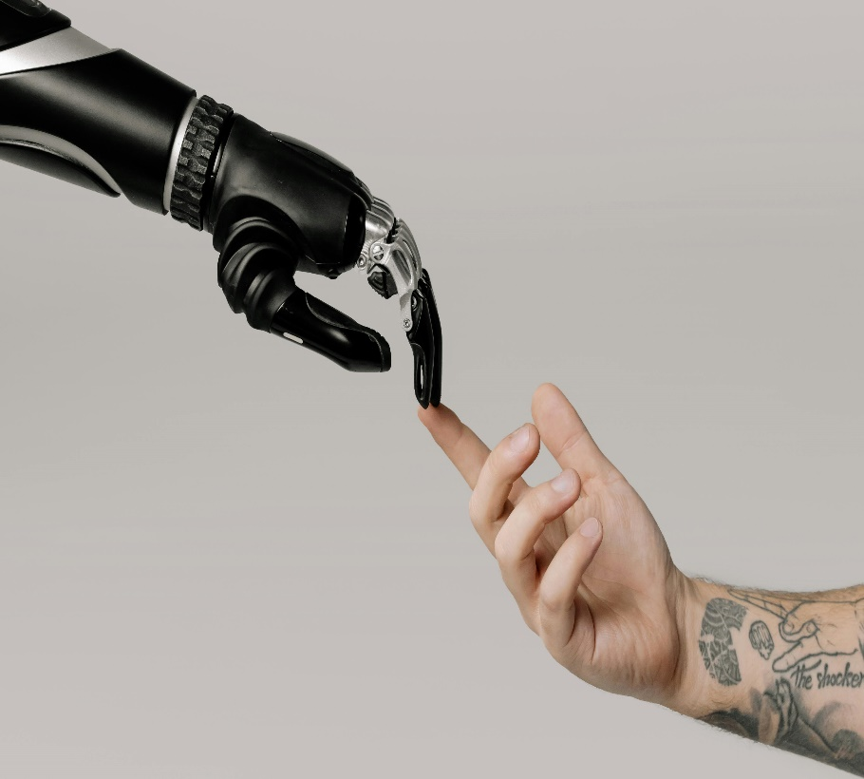
OBJECTIVES
OBJECTIVES
The objective is to specially reduce the manpower and time consumption. Allows teachers to focus more on teaching and less on paperwork.
In the manual system, it may be possible that the marks given to two same answers are different.
This model aims to eliminate human error, thereby enhancing grading accuracy and ensuring consistency.
It automates grade entry, streamline access to evaluated answer booklets and simplify revaluation process.

Slide 6
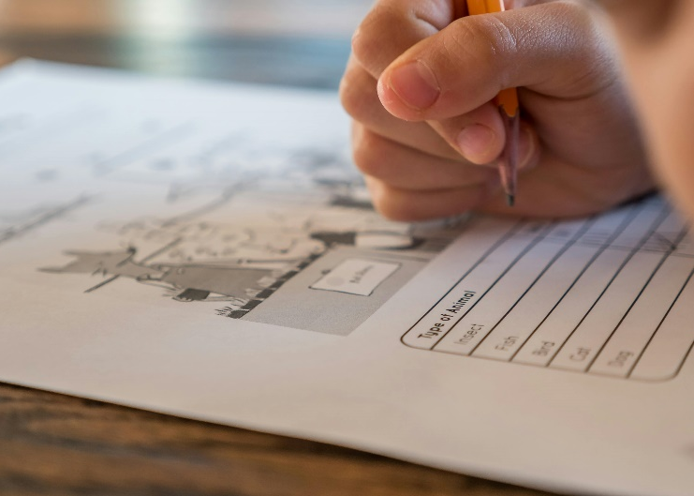
EXISTING SYSTEM
In the existing grading system, teachers manually evaluate student answer booklets. This process typically involves significant time and effort, as teachers must carefully review each answer, provide feedback, and record grades manually.
There is currently automation only for evaluating MCQs or image-based assessments, but no system for evaluating answer booklets in PDF format.
It uses BERT which requires more computational resources and time for training data.
The existing system faces challenges as EasyOCR does not accurately extract text, leading to errors in the grading process.

Slide 7
PROPOSED SYSTEM
Our proposed system introduces automation for evaluating answer booklets in PDF format. Leveraging Tesseract OCR, Natural Language Processing (NLP), and Machine Learning techniques, it analyzes student responses against an answer key dataset.
This approach enables automatic verification of answer booklets and assignment of grades without manual intervention.
Additionally it automates the entry of grades into students result pages, to avoid administrative burden.
The website integrates user authentication and database access for streamlined evaluation processes.

Slide 8
LITERATURE SURVEY
Title | Source | Year | Techniques/ Algorithm | Merits | Demerits
Manual Grading System for Image based assessments | IEEE | 2023 | Natural Language Processing (NLP) | Enables quick and accurate grading, optimizing efficiency and promoting fairness in assessments | Limits assessment to only for image based format
Automation implemented for multiple-choice questions (MCQs) | International Research Journal of Engineering and Technology (IRJET) | 2021 | Deep Learning | Allows for rapid grading and scalability, especially in large classes. | Limits assessment to only multiple-choice questions.
Revolutionizing Subjective Answer Evaluation with Machine Learning | International Journal of Computer Science and Mobile Computing (IJCSMC) | 2022 | Machine Learning | Speeds up grading, reducing manpower and assessment time. | Only grading based on keywords not definitions.

Slide 9
WORKFLOW DESIGN
INPUT
PRE-PROCESSING
FEATURE EXTRACTION
TEXT RECOGNITION
NLP TECHNIQUES
DATA SPLITTING
CLASSIFICATION
EVALUATE THE ANSWER

Slide 10
ARCHITECTURE OF PROPOSED MODEL
ANSWER BOOKLET PDF
PROCESSING MODEL
EXTRACTING TEXT FROM PDF
STORING EXTRACTED TEXT
PROVIDING MARKS FOR ANSWER SHEET
ANSWER KEY DOCUMENT
COMPARING KEYWORDS ANALYSE

Slide 11
REQUIREMENTS
HARDWARE REQUIREMENTS:
System : Intel Core i5 Processor
Hard Disk : 500 GB
Monitor : 15’’ LED
Input Devices : Keyboard and Mouse
RAM : 4 GB
SOFTWARE REQUIREMENTS:
Operating System : Windows 10
Coding Language : Python
Dataset : Answer Key Dataset

Slide 12
PROPOSED ALGORITHM
Optical Character Recognition
The method of recognizing and digitizing text is known as Optical Character Recognition. It helps to reduce our human effort and mistakes which are made manually.
In the early days when OCR was introduced, it can work with only specific fonts. Recently the OCR methods are more sophisticated that they can even recognize people’s handwriting from documents, which is termed as intelligent character recognition.
Natural Language Processing
Natural language processing helps computers communicate with humans in their own language and scales other language-related tasks.

Slide 13
PROPOSED ALGORITHM
Decision Tree
Decision trees are represented as tree structures, where each internal node represents a feature, each branch represents a decision rule, and each leaf node represents a prediction.
The algorithm works by recursively splitting the data into smaller and smaller subsets based on the feature values.
Library
TKinter
PYPDF2
MYSQL Connector

Slide 14
MODULE 1
STUDENT DETAILS ANALYSIS MODULE
Involves collecting comprehensive student information from various sources.
Extracts relevant features from the preprocessed data for analysis.
Applies machine learning algorithms to predict student performance
Integrates with educational platforms for easy access and usability.
ANSWER SHEET ANALYSIS MODULE
Acquires digital copies of answer sheets, whether scanned or in PDF format.
Utilizes OCR techniques to extract text or handwriting from the sheets.

Slide 15
MODULE 2
MARK EVALUATE MODULE
Extracts relevant features from the preprocessed data to provide meaningful input for machine learning models.
Ensures fair and consistent grading practices while enhancing accuracy and reliability over time through machine learning algorithms.
Allows educators to focus on more value-added tasks, promoting transparency in grading based on objective criteria.

Slide 16
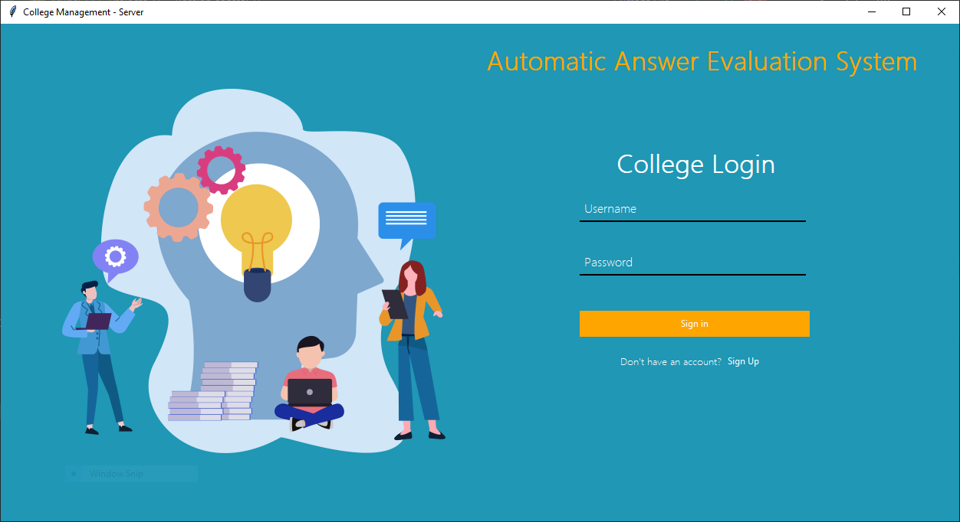
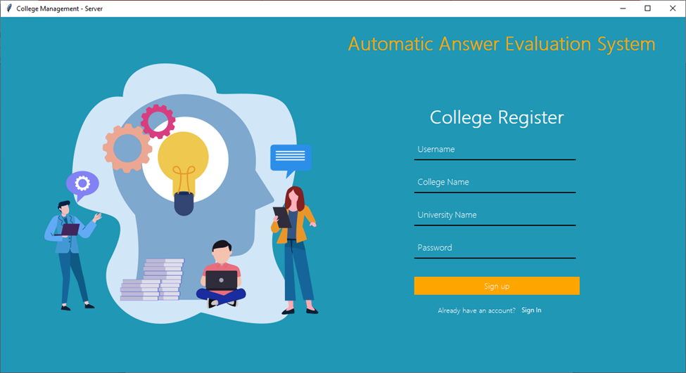
OUTPUT
1. LOGIN PAGE
2. COLLEGE REGISTRATION

Slide 17

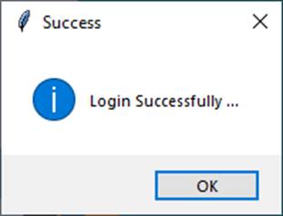
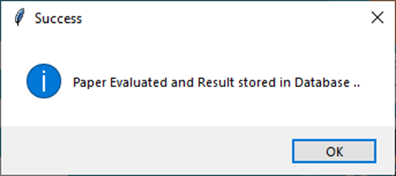
OUTPUT
3. LOGIN SUCCESSFULL
5. EVALUATED SUCCESSFULL
4. UPLOAD STUDENT DATA

Slide 18
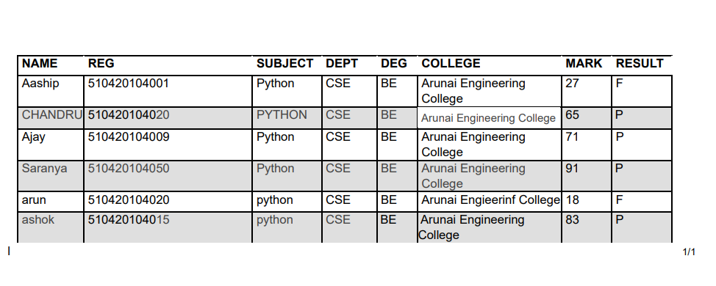
OUTPUT
6. STUDENT DATABASE

Slide 19

CONCLUSION
In this paper, we have developed an algorithm which will evaluate theoretical answers and give marks according to the keyword matching which will reduce manual work and saves time with faster result evaluation. A person should collect the answer copy from the student and scan it. The machine will take the image as input and will evaluate the answer based on the length of the answer, definitions and important keywords covered which are specified by the teacher with each answer which is to be evaluated.

Slide 20

FUTURE WORK
This model can be trained for different languages across India. In this, we can collect dataset of different handwritten languages. Hence a answer with language other than English can be evaluated. System will also evaluate the overwritten alphabets and other words with absolute accuracy. Students can easily download their evaluated answer booklets, verify their grades, easily request reevaluation, simplifying current revaluation process.
Future Scope

Slide 21
REFERENCES
[1] Nandini, P. Uma Maheswari, “Automatic assessment of descriptive answers in online examination system using semantic relational features”, The Journal of Supercomputing, 2023.
[2]Aditi Tulaskar, Aishwarya Thengal, Kamlesh Koyande, ”Subjective Answer Evaluation System”, Volume 7 Issue No.4 International Journal of Engineering Science and Computing, Pp.10457-10459, 2022.
[3] Vimal P. Parmar, C K Kumbharana, ”Analysis Of Different Examination Patterns Having Question Answer Formulation, Evaluation Techniques And Comparison Of MCQ Type With One Word Answer For Automated Online Examination” Interna- tional Journal of Scientiﬁc and Research Publications, Volume 6, Issue 3, Pp.459- 463, 2021.
[4] asmitha dhokrat, gite hanumant r, c. namrata Mahender, Automated Answering For SubjectiveExamination”, International Journal Of Computer Applications.VOL.56. Pp.14-17, 2021.

Slide 22
REFERENCES
[5] Pranali Nikam, Mayuri Shinde, Rajashree Mahajan and Shashikala Kadam, Automatic Evaluation of Descriptive Answer Using Pattern Matching Algorithm”, International Journal of Computer Sciences and Engineering, Pp.69-70, 2015.
[6] Ravikumar M, Sampath Kumar S and Shivakumar G Piyush Patil, Sachin Patil, Vaibhav Miniyar, Amol Bandal, ”Subjective Answer Evaluation
Using Machine Learning”, International Journal of Pure and Applied Mathematics, Pp.01-
13, 2018.
[7] Dhananjay Kulkarni, Ankit Thakur, Jitendra Kshirsagar, Y. Ravi Raju4, ”Auto-matic OMR Answer Sheet Evaluation using Efﬁcient Reliable OCR System”, In- ternational Journal of Advanced Research in Computer and Communication Engineering, Vol. 6, Issue 3, Pp.688-690, 2017

Slide 23
THANK YOU
DEPARTMENT OF
CSE

